Slide 1
Smart hospital with smart navigation
present by:
Giri R
Deepak kumar M
Information technology
Bannari Amman institute of technology

Slide 2


Slide 3
PROBLEM DEFINITION
Very difficult to retrieve and to find particular information
The information generated by various transactions takes time and efforts to be stored at right place.
People don’t know where to go.
Take time to get I’d from reception.

Slide 4
Objective
It is the user friendly application for Hospital which reduces the burden and helps to manage all sections of hospital like reception, lab, inpatient/outpatient management and Billing etc., which improve the processing efficiency.
It deals with the automating tasks of maintaining of laboratory And Diagnosis. In Hospital, Billing management is the key process.

Slide 5
ABSTRACT
An Smart Hospital Management System (SHMS) is an application.Intelligent front desk information service to assist the patients learn about the doctor’s appointment times, laboratory tests, their relevant departments, and the specific medicine about his/her medical situation.In place of Reception build the application to interact with patient .The application allows the hospital to store the patient records, the logs of laboratory or radiological examinations and clinical actions.

Slide 6
INtroduction
SHMS
Administrative, financial and clinical aspects of a hospital.
Laboratory information system
Chatbot
Map

Slide 7
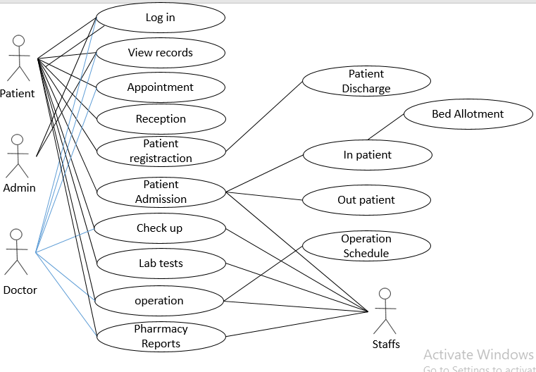
Use case

Slide 8
Functions/modules
Home
Admin
Doctor
Staff
Patient
Chatbot Assistant
Direction
Record maintain

Slide 9
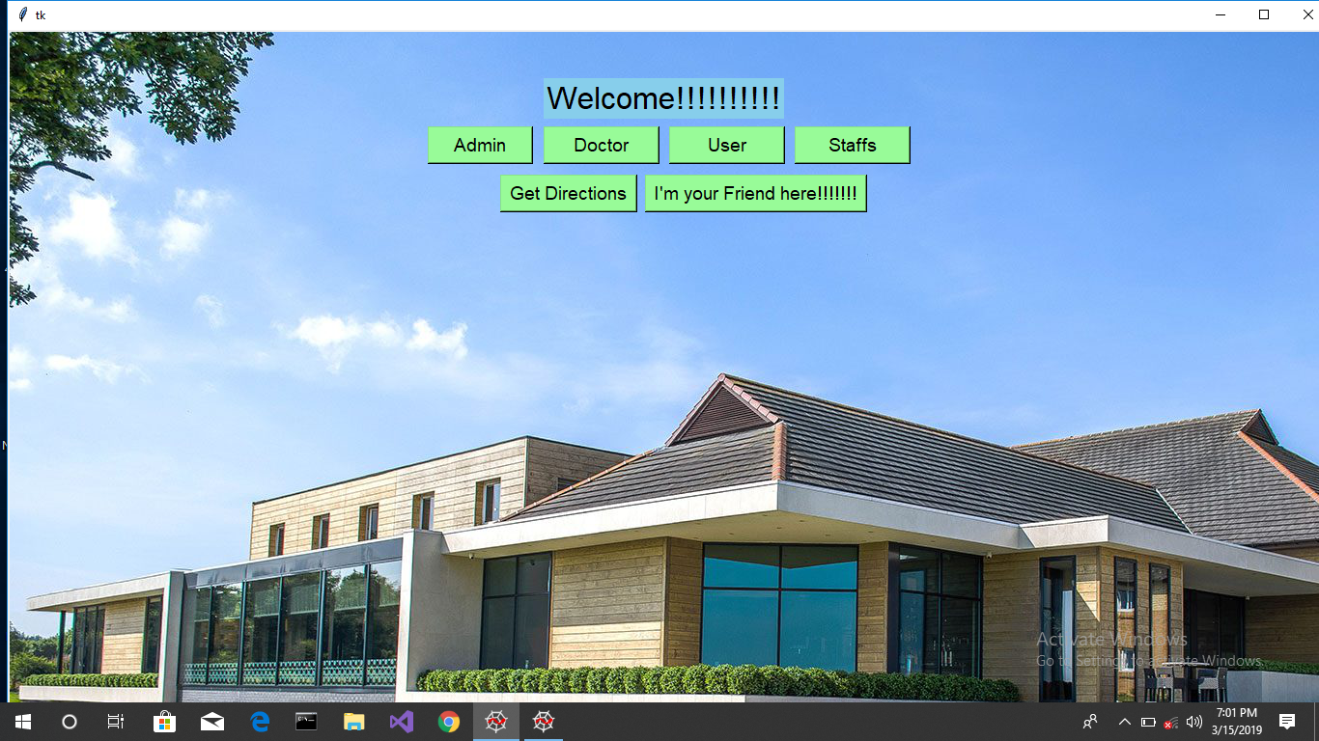

Slide 10

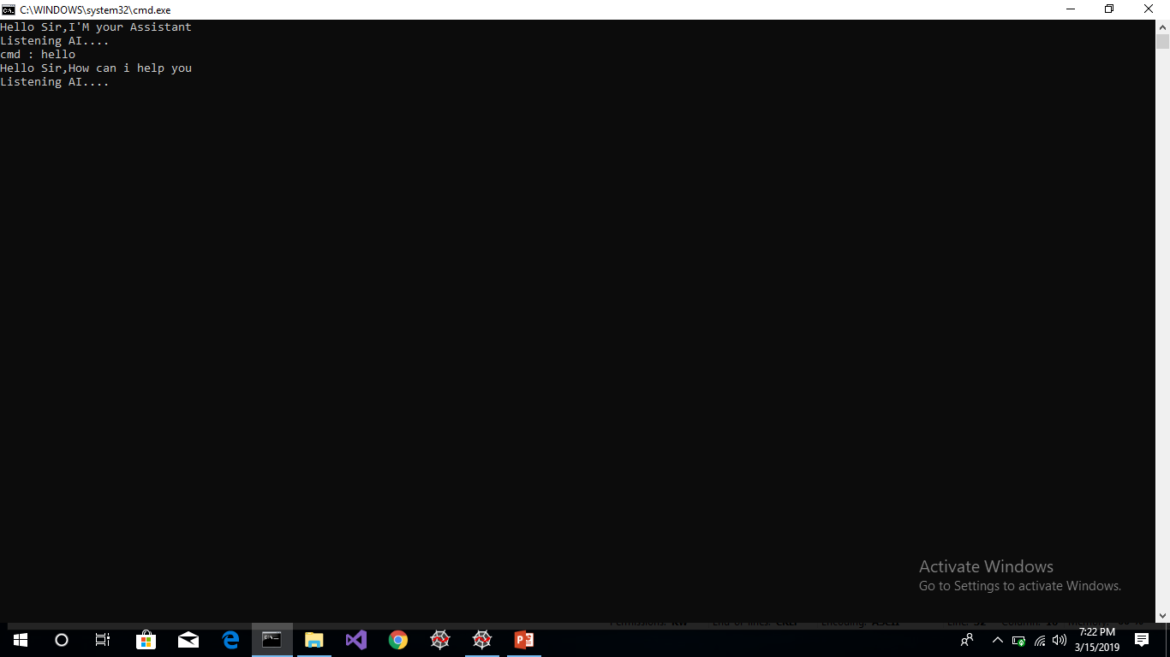

Slide 11
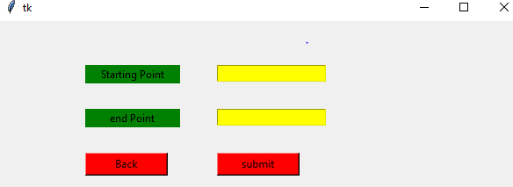
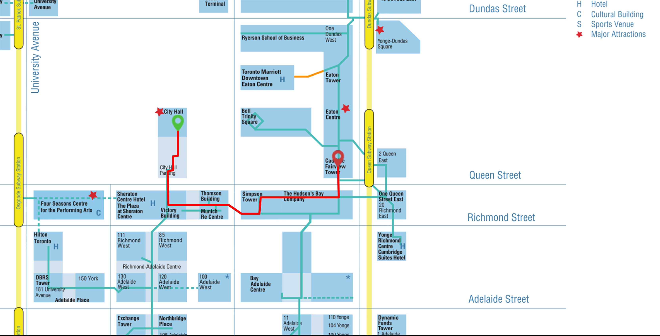

Slide 12
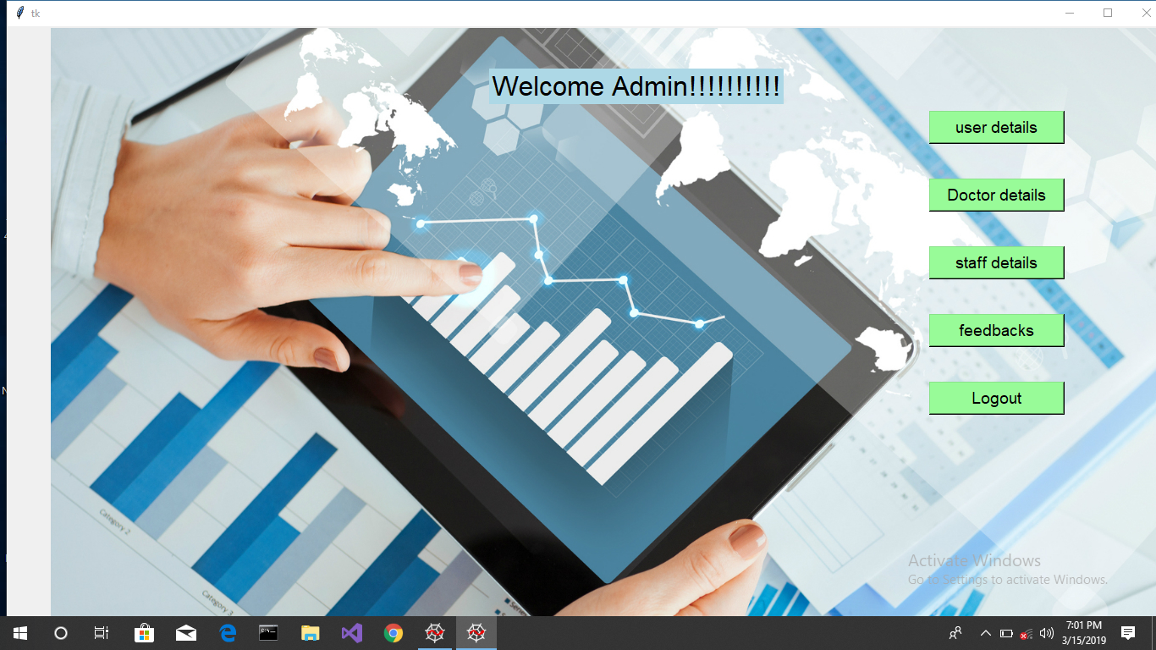

Slide 13
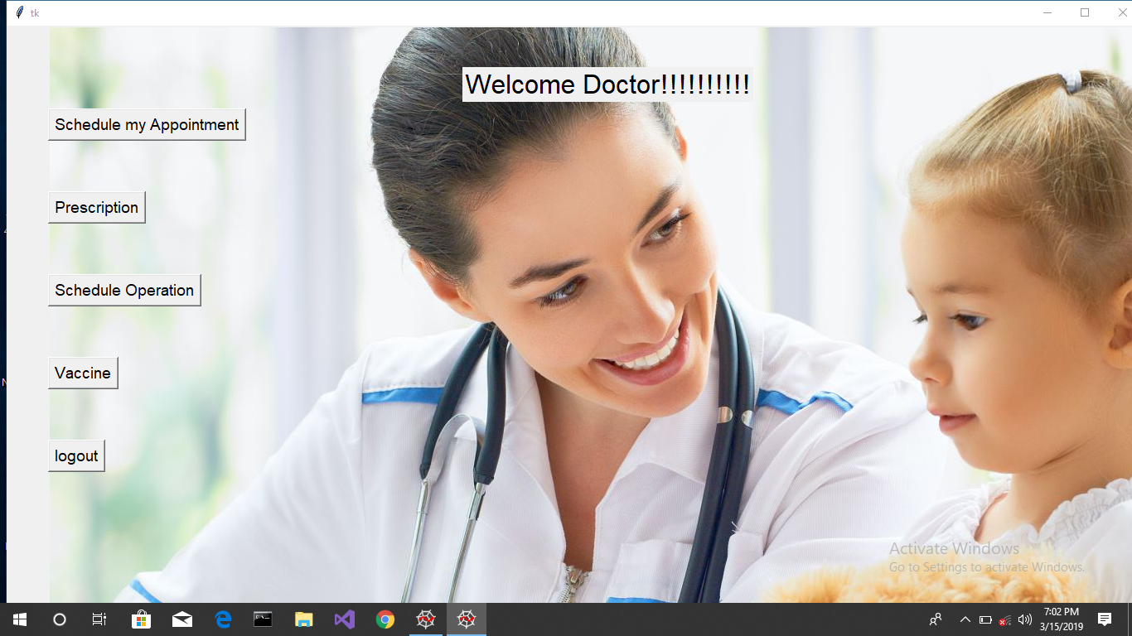

Slide 14
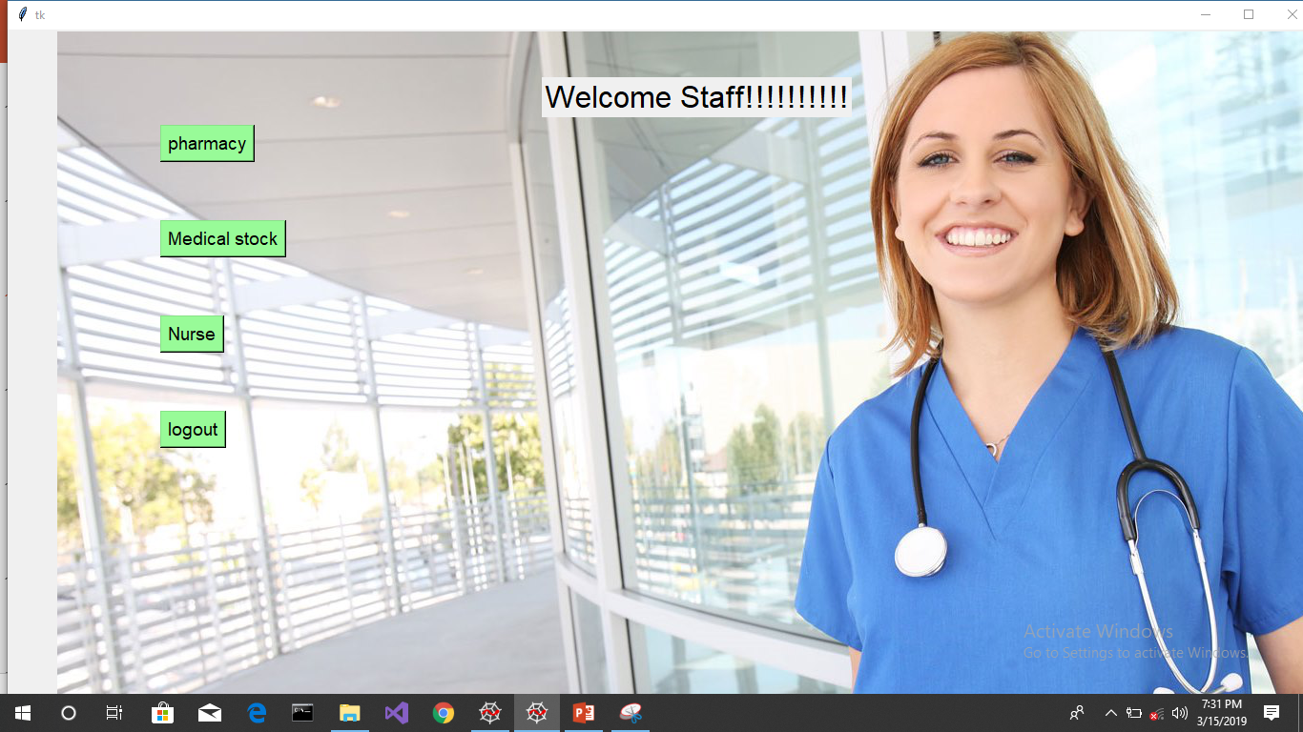

Slide 15




Slide 16
Techniques
Anaconda
SQLite
Pycharm
Python modules

Slide 17
conclusion
Computerizing
Easy and effective storage
Backup as per the requirement.
Smart mapping
Chat bot

Slide 18
references
[1]Charalampos Doukas, Thomas Pliakas, and Ilias Maglogiannis,” Mobile Healthcare Information Management utilizing Cloud Computing and Android OS” 32nd Annual International Conference of the IEEE EMBS Buenos Aires, Argentina, August 31 - September 4, 2010.
[2]Hairong Yan, Hongwei Huo, Youzhi Xu, and Mikael Gidlund,” Wireless Sensor Network Based E-Health System –Implementation and Experimental Results” 0098 3063/10/$20.00 © 2010 IEEE
[3]Armstrong, N. , Nugent C.D. , Moore G. ,Finlay D.D. , Developing smartphone applications for people with Alzheimer's disease, Information Technology and Applications in Biomedicine (ITAB), 2010 10th IEEE International Conference on, 3-5 Nov. 2010

Slide 19
[4] Luis U. Hernandez Munoz and Sandra I. Woolley,” A user-centered mobile health device to manage life-threatening anaphylactic allergies and provide support in allergic reactions” Proceedings of the 9th International Conference on Information Technology and Applications in Biomedicine, ITAB 2009, Larnaca, cyprus, 5-7 November 200
[5] V. Manoj Kumar, A. Keerthana, M. Madhumitha, S.Valliammai and V. Vinithasri, “Sanative Chatbot For Health Seekers” in International Journal Of Engineering And Computer Science, March 2016; 16022-16025
[6] Shubham Jayawant, “Medic: An Artificially Intelligent System to Provide Healthcare Services to Society and Medical Assistance to Doctors” in International Conference on Communication and Electronics Systems, October 2016

Slide 20


